Slide 1
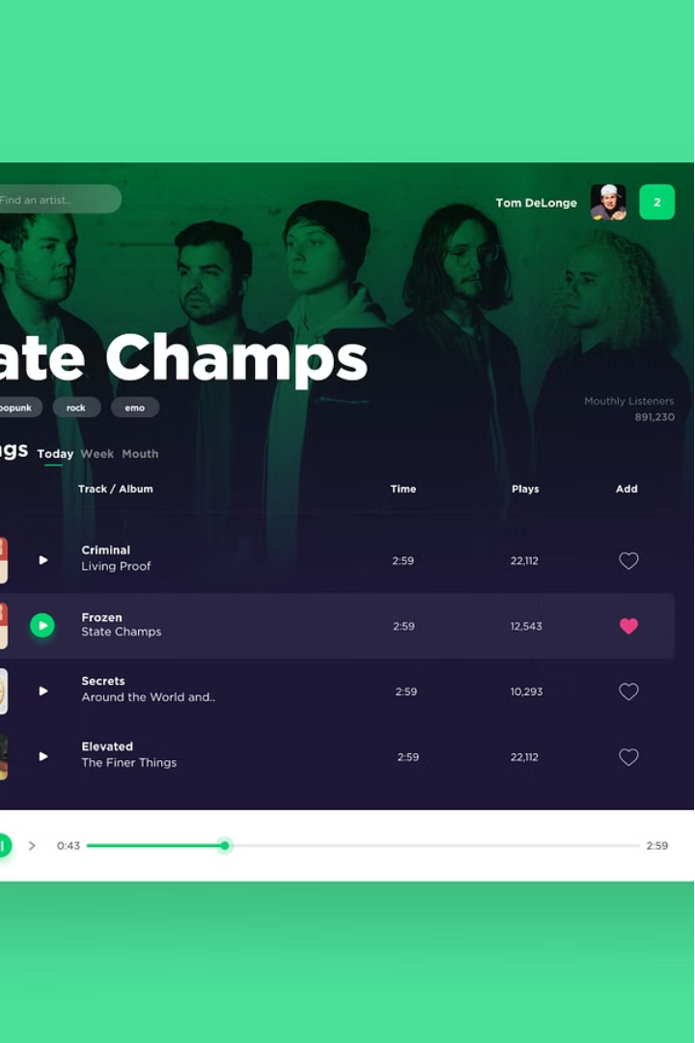

Spotify Song Insights Dashboard
The Spotify Song Insights Dashboard aims to uncover valuable trends and insights in Spotify song data that can guide strategic decision-making in the music industry. By analyzing data on genre popularity, artist engagement, playlist characteristics, and temporal patterns, this dashboard provides a comprehensive view of the evolving music landscape.

Slide 2
Genre Popularity
Dominant Genres
Emerging Trends
Visualization
The dashboard analyzes the relative popularity of different music genres on Spotify, identifying the most dominant and widely-listened-to genres. This information can help music professionals understand current listener preferences and guide their content and marketing strategies.
By tracking changes in genre popularity over time, the dashboard can also uncover emerging trends and shifts in listener preferences. This can inform decisions around talent scouting, genre diversification, and adapting to evolving market demands.
The genre popularity insights are presented through visually compelling charts and graphs, such as bar charts, Line charts, and treemaps, allowing for easy interpretation and identification of key trends.

Slide 3
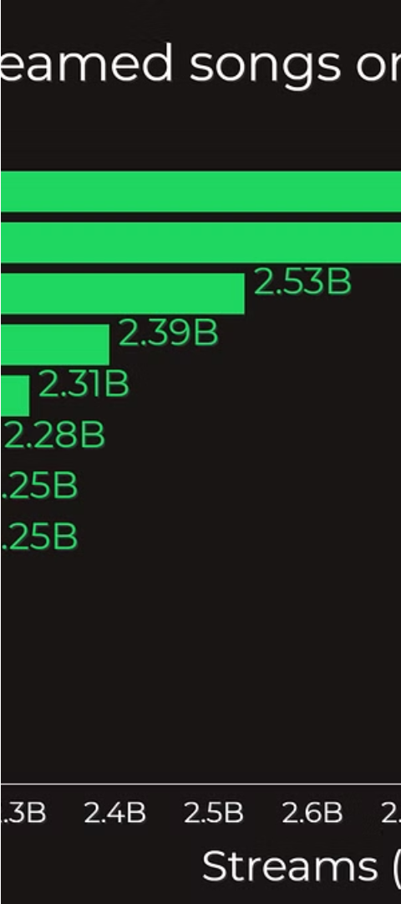



Temporal Trends
Song Popularity
The dashboard examines how song popularity on Spotify changes over time, identifying seasonal patterns, significant events, or other factors that may influence listener preferences and engagement.
Genre Shifts
The dashboard also tracks changes in genre popularity over time, allowing music professionals to anticipate and adapt to evolving listener trends and preferences.
Listener Behavior
By analyzing temporal trends in listener behavior, such as streaming patterns, playlist creation, and sharing activities, the dashboard can provide valuable insights to guide content and marketing strategies.

Slide 4




Visualizations and Dashboards
Intuitive Visualizations
Comprehensive Dashboards
Data-Driven Insights
The Spotify Song Insights Dashboard utilizes a variety of visually compelling charts and graphs, such as bar charts, pie charts, and treemaps, to present the data in a clear and easy-to-understand manner.
The dashboard consolidates all the key insights and trends into a single, interactive platform, allowing music professionals to explore the data, uncover patterns, and make informed decisions.
By leveraging advanced data analysis techniques, the dashboard provides music professionals with a deep understanding of the Spotify ecosystem, empowering them to make strategic decisions based on reliable, data-driven insights.

Slide 5
Competitive Advantage
1
Informed Decision-Making
2
Adaptability to Trends
3
Targeted Marketing and Promotion
By closely monitoring genre popularity, artist engagement, playlist characteristics, and temporal trends, the dashboard enables music professionals to quickly identify and adapt to changing market conditions and listener preferences.
The Spotify Song Insights Dashboard equips music industry professionals with the data and insights needed to make more informed, strategic decisions that can give them a competitive edge in the evolving music landscape.
The insights provided by the dashboard can inform targeted marketing and promotion strategies, allowing music professionals to effectively reach and engage their target audience on the Spotify platform.

Slide 6
Conclusion
Comprehensive Insights
The Spotify Song Insights Dashboard offers a holistic view of the music industry, providing valuable data and insights across various aspects, including genre popularity, artist engagement, playlist characteristics, and temporal trends.
Strategic Decision-Making
By leveraging the insights derived from the dashboard, music industry professionals can make more informed, data-driven decisions that can help them maintain a competitive advantage in the evolving music landscape.
Adaptability and Innovation
The dashboard's ability to track and analyze changing trends and patterns empowers music professionals to quickly adapt to market shifts and explore innovative strategies to stay ahead of the curve.

